Slide 1

Performance Enhancement and Security Analysis of Satellite FSO/QKD Systems using HAP-based Relaying and ARQ
Presenter: Nam Nguyen
Electrical Engineering and Computer Science
Oregon State University
Oregon Sate University

Slide 2
Content
Problem Statement
Research Idea and Solution Approach
Contributions
Evaluation Method
Numerical Results
Conclusions and Future Outlook
1
Oregon State University

Slide 3
I. Problem Statement
1. Motivation
Secure communications for sensitive information plays a crucial role.
Conventional key distribution protocols relying on computational complexities are vulnerable to future advances in computer hardware and algorithms.
Quantum key distribution (QKD) promises the principle unconditional security by applying the law of quantum mechanics.
2
Oregon State University

Slide 4
I. Problem Statement
2. Quantum Key Distribution System
Advantages
Not require highly computational cryptography algorithms.
Unconditional security
Achievements
A fiber QKD network in metropolitan area of Tokyo (2011).
A QKD fiber network between Beijing and Shanghai, 2000 km (2015).
A satellite QKD system between Beijing and Vienna, 7600 km (2016).
Figure 1. Symmetric-key cryptography model using QKD.
3
Oregon State University
Notes:
…

Slide 5
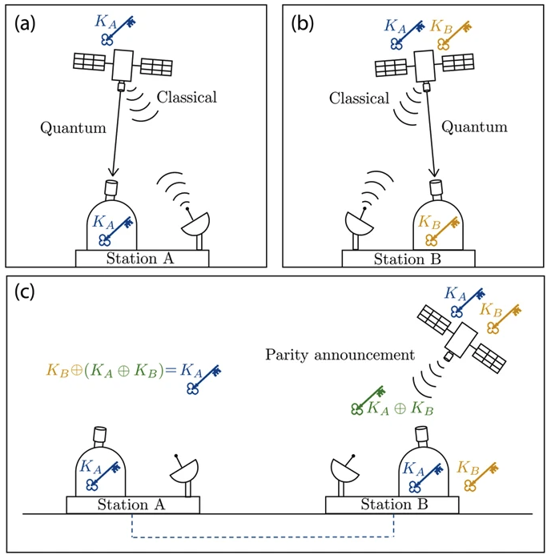
I. Problem Statement
3. Satellite QKD System and Challenges
The previous studies:
Communication distance: 7600 km [4].
Key rate: 2 Kbps [5].
Performance: Key may be erroneous.
Limitations:
Communication distance is limited.
Key rate is limited.
Need to improve the reliability of key.
Figure 2. The common satellite QKD scheme (Bedington et al. 2017).
4
Oregon State University

Slide 6


II. Research Idea and Solution Approach
Research Idea
Global QKD network for secure communication:
Bit rate is around Gbps
High reliability.
Communication distance is over hundred kilometer.
2. Solution Approach
Proposed solution approach:
Key retransmission technique helps improve the reliability.
Relaying technique helps improve the performance.
5
Oregon State University

Slide 7
III. Contributions
Propose the satellite QKD system scheme using key retransmission and relaying technique to enhance the performance and reliability.
Analyze the system performance: key loss rate (KLR) and delay outage rate.
Investigate the secrecy performance: quantum bit error rate (QBER) and ergodic secret-key rate.
6
Oregon State University

Slide 8
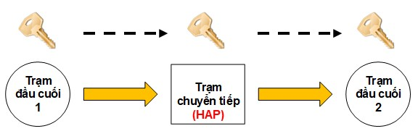
IV. Evaluation Method
1. Key Retransmission and HAP-Based Relaying Technique
Node 1
Relay
(HAP)
Node 2
Figure 4. HAP-based relaying scheme.
7
Figure 3. Key retransmission scheme.

Slide 9
IV. Evaluation Method
2. System Model
Figure 5. Satellite FSO/QKD system using HAP-based relaying and link-layer ARQ technique.
8
Oregon State University

Slide 10
IV. Evaluation Method
2. System Model
Figure 6. The proposed satellite FSO/QKD system using HAP-based relaying and link-layer ARQ technique.
9
Oregon State University

Slide 11
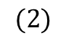
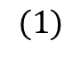
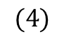
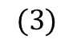
IV. Evaluation Method
3. Channel Models
Free-space loss
Path loss
Beam spreading loss
Atmospheric turbulence
$$(1)$$
$$(2)$$
$$(3)$$
$$(4)$$
10
Oregon State University

Slide 12
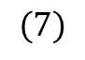
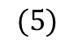
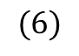
IV. Evaluation Method
4. Performance Analysis
Quantum Bit Error Rate (QBER)
$$(5)$$
where $P_{sift}$ is the probability that Bob uses the same bases as Alice’s to measure the received photons. $P_{error}$is the probability that there is a number of erroneous bits in the sifted key.
The joint probabilities when Alice transmits bits “0” and “1”, averaged over fading channel
Satellite-to-HAP link
$$(6)$$
HAP-to-ground link
$$(7)$$
11
Oregon State University

Slide 13
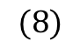
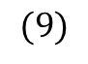
IV. Evaluation Method
4. Performance Analysis
Quantum Key Error Rate (QKER )
Satellite-to-HAP link
HAP-to-ground link
$$(8)$$
$$(9)$$
12
Oregon State University
Notes:
).

Slide 14
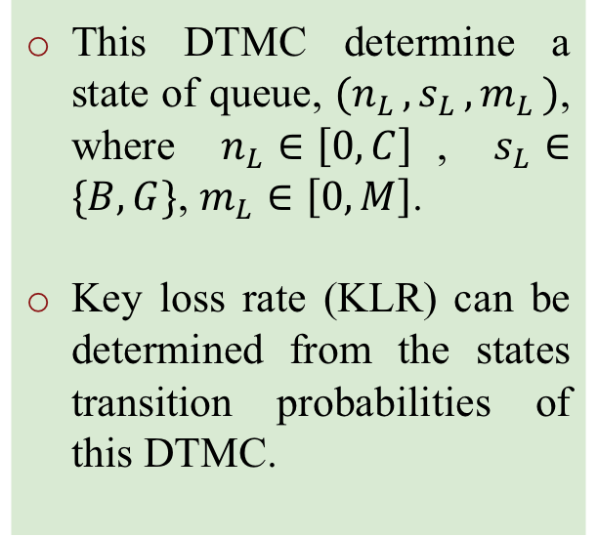
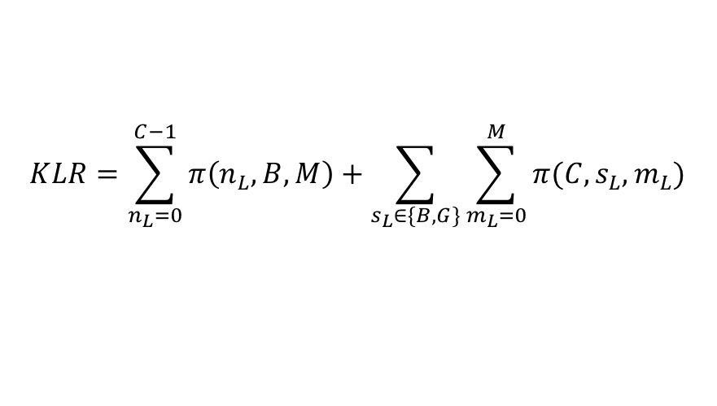
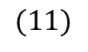
IV. Evaluation Method
4. Performance Analysis
Key Loss Rate
Figure 8. The states transition probabilities of the QKD queue-associated Discrete-Time Markov Chain (DTMC).
This DTMC determine a state of queue, $(n_{L },s_{L },m_{L })$, where $n_{L}∈\left[0,C\right]$, $s_{L}∈\{B,G\}$, $m_{L}∈\left[0,M\right]$.
Key loss rate (KLR) can be determined from the states transition probabilities of this DTMC.
Key loss rate can be determined as follows:
$$KLR=\sum_{n_{L}=0}^{C−1}{π\left(n_{L},B,M\right)+\sum_{s_{L}∈\{B,G\}}{\sum_{m_{L}=0}^{M}{π(C,s_{L},m_{L})}}}$$
$$(11)$$
13
Oregon State University

Slide 15
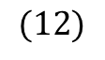
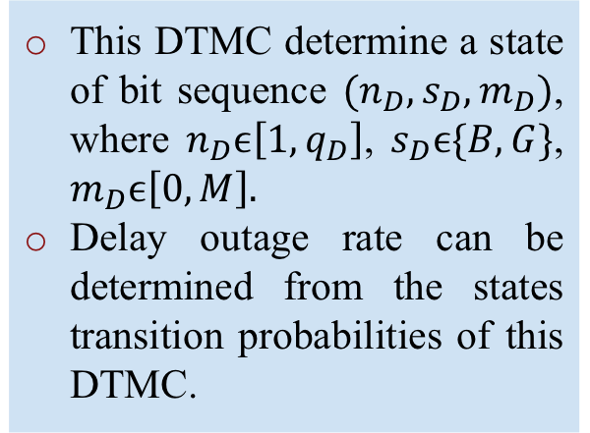
IV. Evaluation Method
4. Performance Analysis
Delay Outage Rate
Figure 9. The states transition probabilities of the QKD bit sequence-associated DTMC.
This DTMC determine a state of bit sequence $(n_{D},s_{D},m_{D})$, where $n_{D}ϵ\left[1,q_{D}\right]$, $s_{D}ϵ\{B,G\}$, $m_{D}ϵ\left[0,M\right].$
Delay outage rate can be determined from the states transition probabilities of this DTMC.
The conditional probability which queued delay of each obtain bit sequence is greater than $D/τ_{bs}$ time slots:
$$(12)$$
14
Oregon State University

Slide 16
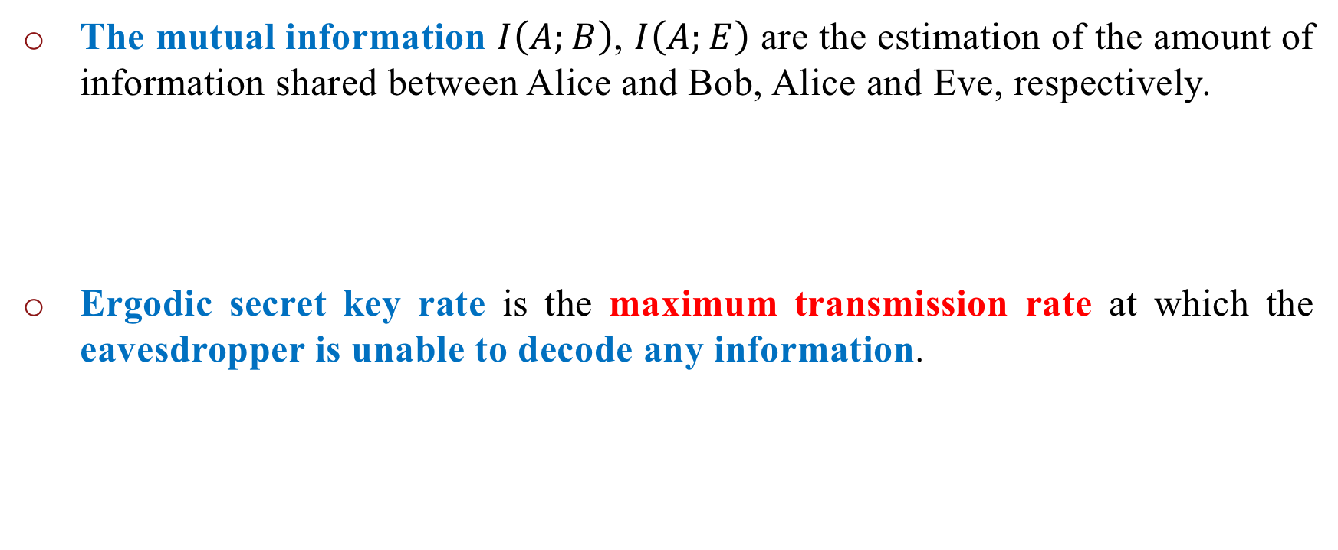
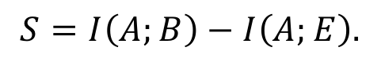
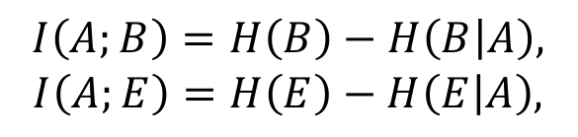
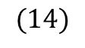
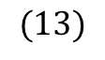
IV. Evaluation Method
5. Secrecy Performance Analysis
Ergodic Secret-Key Rate
The mutual information $I\left(A;B\right)$, $I\left(A;E\right)$ are the estimation of the amount of information shared between Alice and Bob, Alice and Eve, respectively.
Ergodic secret key rate is the maximum transmission rate at which the eavesdropper is unable to decode any information.
$$I\left(A;B\right)=H\left(B\right)−H\left(B | A\right),$$
$$I\left(A;E\right)=H\left(E\right)−H\left(E | A\right),$$
$$(13)$$
$$S=I\left(A;B\right)−I\left(A;E\right).$$
$$(14)$$
15
Oregon State University

Slide 17
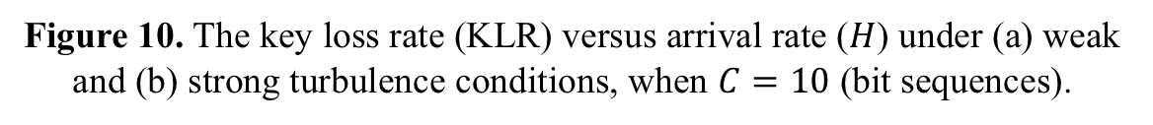
V. Numerical Results
1. Key Loss Rate (KLR) Versus Arrival Rate ($H$)
Figure 10. The key loss rate (KLR) versus arrival rate ($H$) under (a) weak and (b) strong turbulence conditions, when $C=10$ (bit sequences).
16
Oregon State University

Slide 18
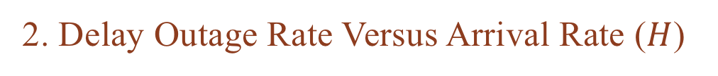
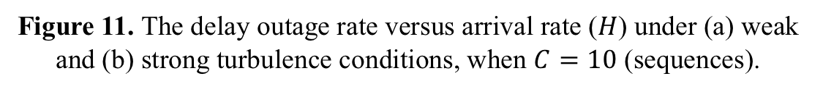
V. Numerical Results
2. Delay Outage Rate Versus Arrival Rate ($H$)
Figure 11. The delay outage rate versus arrival rate ($H$) under (a) weak and (b) strong turbulence conditions, when $C=10$ (sequences).
17
Oregon State University

Slide 19
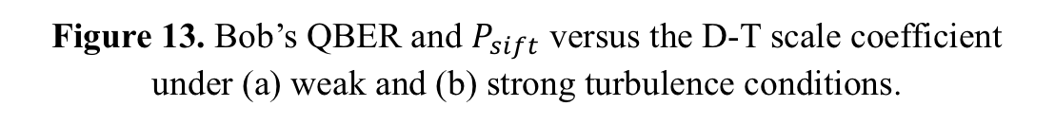
V. Numerical Results
4. Quantum Bit Error Rate Versus D-T Scale Coefficient
Figure 13. Bob’s QBER and $P_{sift}$ versus the D-T scale coefficient under (a) weak and (b) strong turbulence conditions.
18
Oregon State University

Slide 20
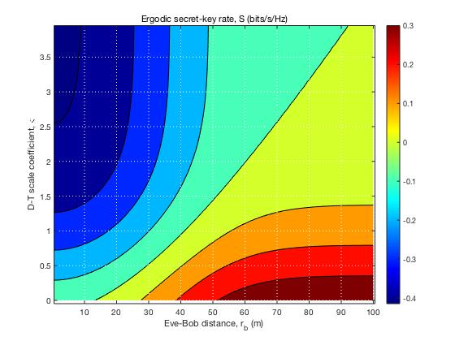
V. Numerical Results
5. Ergodic Secret-Key Rate (S) Versus D-T Scale Coefficient
Figure 14. Ergodic secret-key rate (S) versus D-T scale coefficient and Eve’s distance from ground station under strong turbulence.
19
Oregon State University

Slide 21
VI. Conclusions and Future Outlook
Conclusions
Used the key retransmission and relaying technique for satellite QKD system to enhance the performance and reliability.
Hence, the reliability and performance improve significantly, under strong turbulence condition.
Future Outlook
Implement the proposed system to verify its feasibility and security efficiency.
Use other improvement technique and error correction methods to improve the secrecy performance.
20
Oregon State University

Slide 22
Thank you!
Presenter: Nam Nguyen

